Slide 1
DEEP LEARNING
Abhishek Krishna TM
ENG19CS0011

Slide 2
Deep Neural Networks
An artificial network consists of a pool of simple processing units which communicate by sending signals to each other over a large number of weighted connections. Many Neural networks together forms DNN.
It mainly has dense layers which consists of input, output and dense neurons.

Slide 3
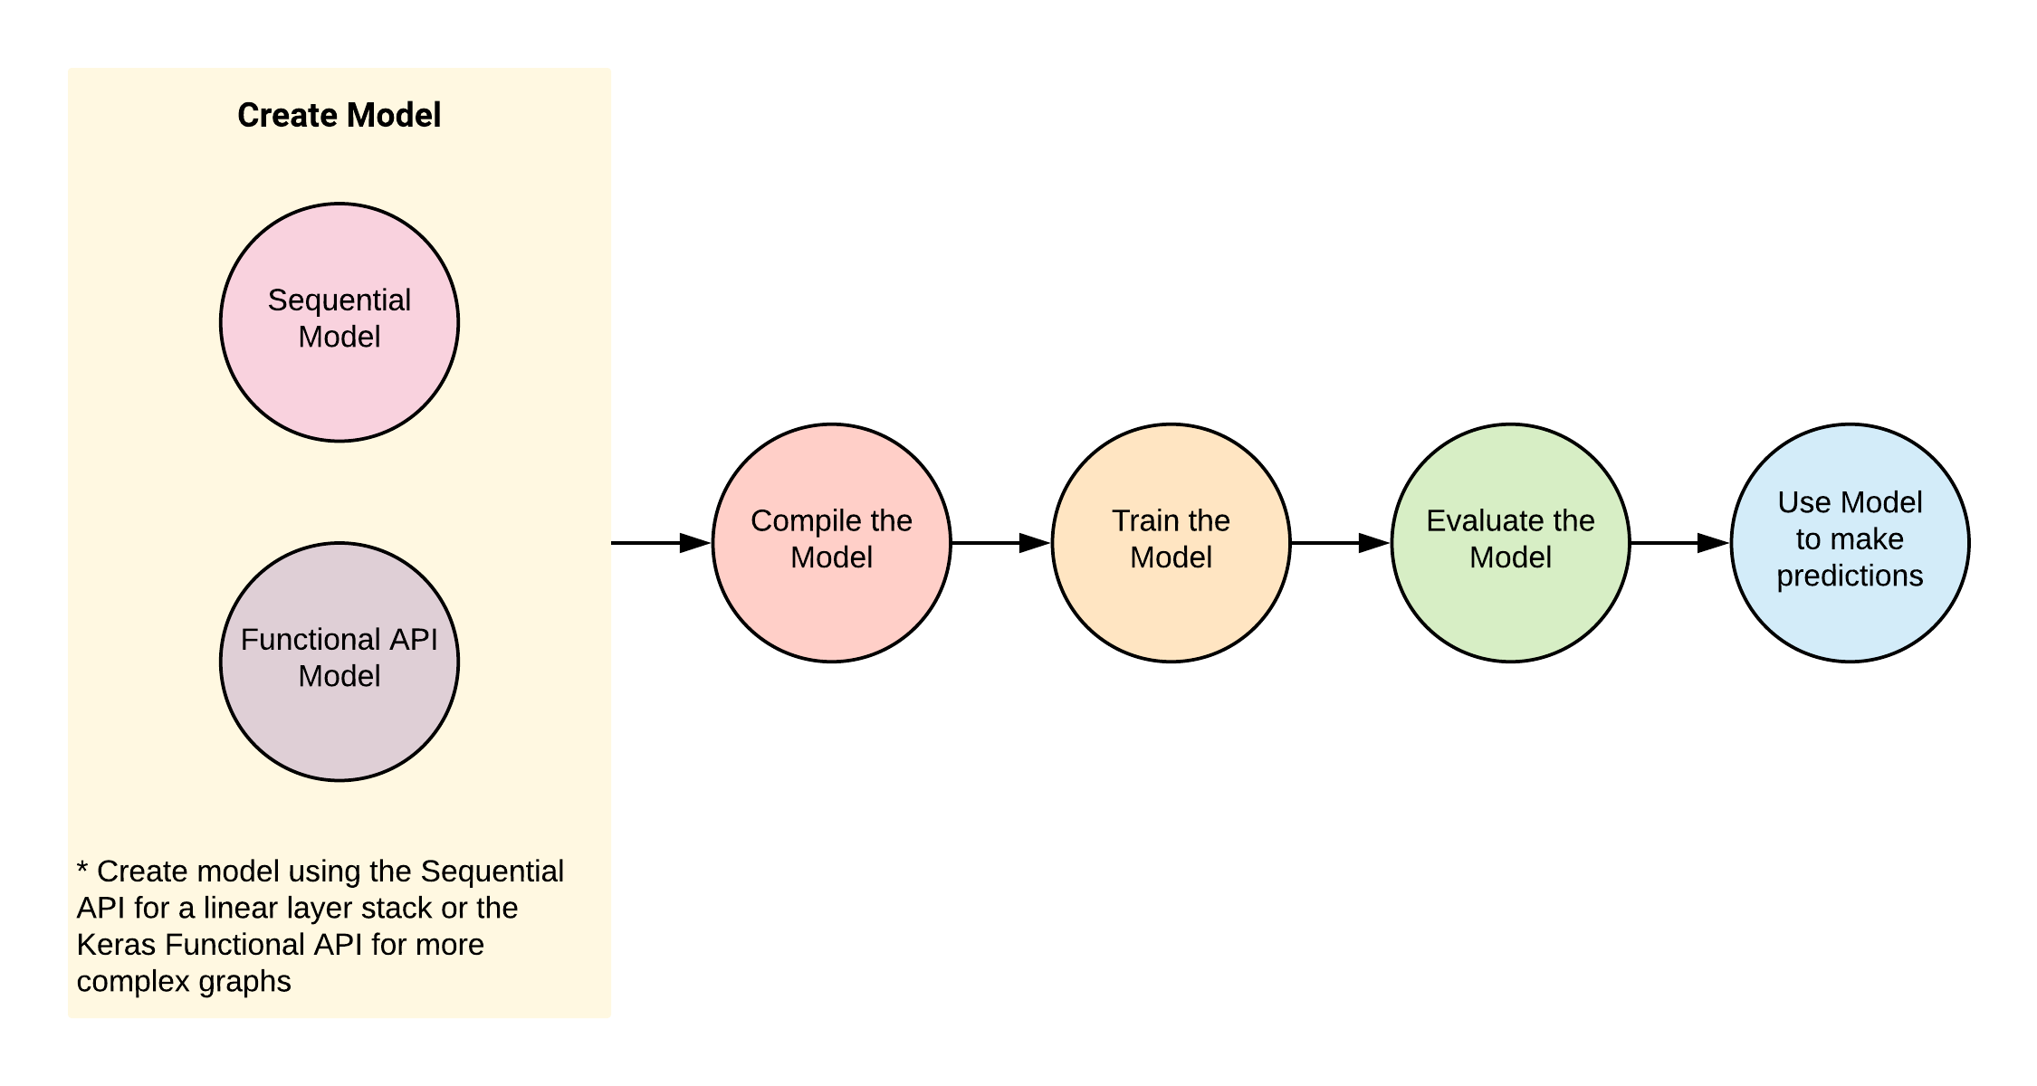
Deep Neural Networks

Slide 4
Forward feedback backward propagation loss function
Feed-forward neural networks take in a fixed amount of input data all at the same time and produce a fixed amount of output each time.It is used for more accuracy purpose.
Backward propagation - Is used to get more accuracy from DNN networks .
It is said to be done when one epoch is completed.
Loss function -Is a component of DNN(neural network), which is for the prediction of the error and to try to reduce the error as much as possible.
All these together makes DNN to be more accurate .

Slide 5
METRICS
A metric is a function that is used to judge the performance of your model.
Metric functions are similar to loss functions, except that the results from evaluating a metric are not used when training the model. Note that you may use any loss function as a metric.
Metrics are used to monitor and measure the performance of a model (during training and testing), and don’t need to be differentiable.
However, if for some tasks the performance metric is differentiable, it can also be used as a loss function (perhaps with some regularizations added to it), such as MSE.

Slide 6
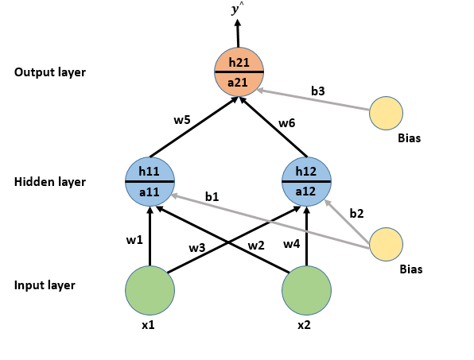
FORWARD PROPAGATION
Fig. Forward Propagation in Neural Network

Slide 7
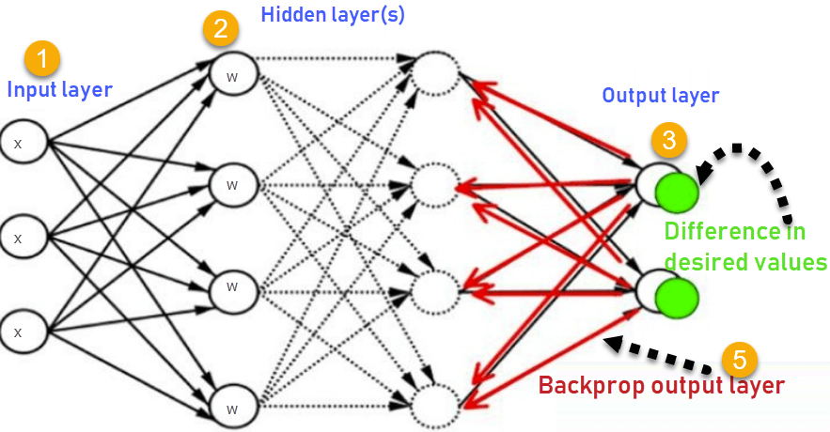
BACKWARD PROPAGATION
Fig. Backward Propagation in Neural Network

Slide 8
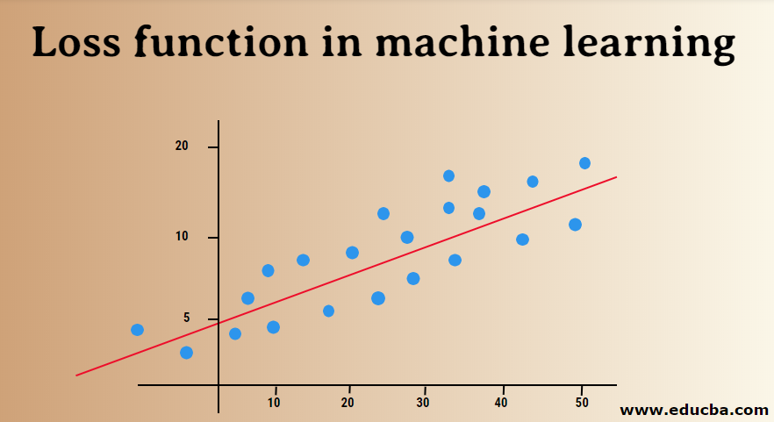
LOSS FUNCTION

Slide 9
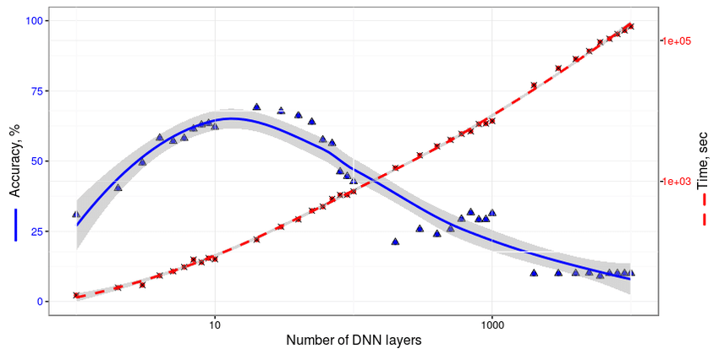
ACCURACY
Fig. Accuracy and Training time of DNN

Slide 10
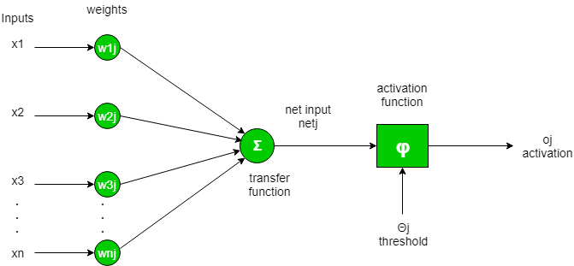
TRANSFER FUNCTIONS
It is used to determine the output of neural network like yes or no. It maps the resulting values in between 0 to 1 or -1 to 1 etc (depending upon the function). It is also known as Activation Functions.
The Activation Functions can be basically divided into 2 types-
Linear Activation Function
Non-linear Activation Functions
Generally, neural networks use non-linear activation functions, which can help the network learn complex data, compute and learn almost any function representing a question, and provide accurate predictions. They allow back-propagation because they have a derivative function which is related to the inputs.

Slide 11
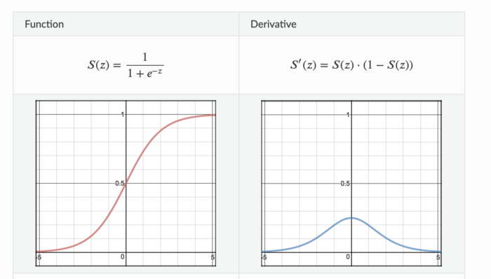
1. Sigmoid Activation Function:
Sigmoid Activation function is very simple which takes a real value as input and gives probability that ‘s always between 0 or 1. It looks like ‘S’ shape.
It’s non-linear, continuously differentiable, monotonic, and has a fixed output range. Main advantage is simple and good for classifier. But big disadvantage of the function is that it gives rise to a problem of “vanishing gradients” because Its output isn’t zero centered. It makes the gradient updates go too far in different directions. 0 < output < 1, and it makes optimization harder. That takes very high computational time in hidden layer of neural network.

Slide 12
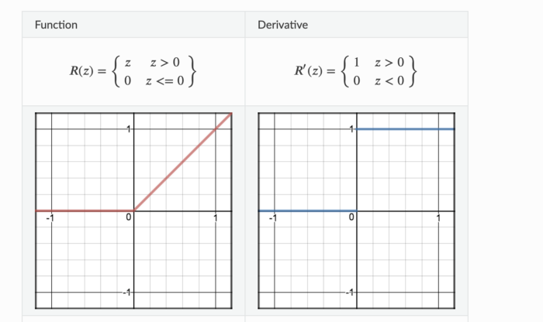
2. ReLU (Rectified Linear Unit):
This is most popular activation function which is used in hidden layer of Neural Network. The formula is deceptively simple: 𝑚𝑎𝑥(0,𝑧)max(0,z). Despite its name and appearance, it’s not linear and provides the same benefits as Sigmoid but with better performance.
It’s main advantage is that it avoids and rectifies vanishing gradient problem and less computationally expensive than tanh and sigmoid. But it also has some draw back. Sometime some gradients can be fragile during training and can die. That leads to dead neurons. In other words, for activations in the region (x<0) of ReLu, gradient will be 0 because of which the weights will not get adjusted during descent. That means, those neurons which go into that state will stop responding to variations in error/ input ( simply because gradient is 0, nothing changes ). So We should be very careful to choose activation function , and activation function should be as per business requirement.

Slide 13
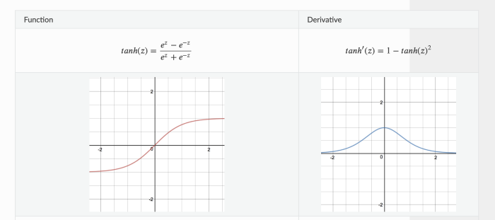
3. Tanh or Hyperbolic tangent:
Tanh helps to solve non zero centered problem of sigmoid function. Tanh squashes a real-valued number to the range [-1, 1].
Derivative function gives us almost same as sigmoid’s derivative function.
It solves sigmoid’s drawback but it still can’t remove the vanishing gradient problem completely.

Slide 14
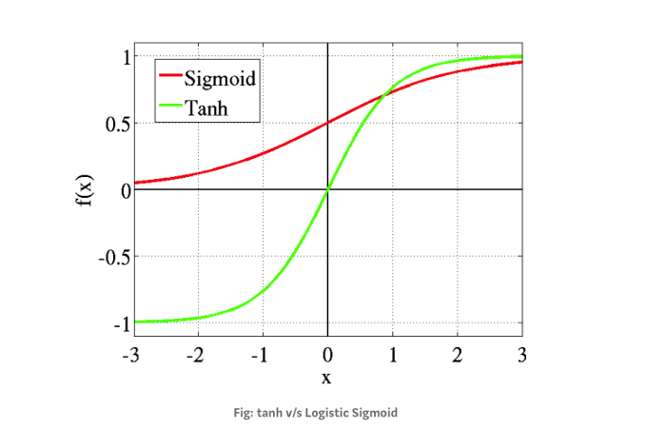
When we compare tanh activation function with sighmoid , this picture give you clear idea.

Slide 15
Overfit underfit and optimal fit
Overfit – is when the errors are least in DNN but it is very complicated as all the points must be connected in the graph.
Underfit - is when the errors are most in DNN but it is very simple as all the points need not be connected in the graph.
Optimal fit – is when there are average errors in DNN but a mathematical equation can be produced by connecting few of the points.

Slide 16
Reference
Google colab - https://colab.research.google.com/drive/1fLTJBD4ROy2SFWIWbqflIj2rjj_8wYMA#scrollTo=TN4Ve8-KjGT1
GitHub -https://github.com/CypherAk007/DeepLearningAssignment_02

Slide 17
Thank you

